Slide 2
CDISC and IHE’s contribution to EHR-enabled research
Becky Kush
George Cole
Landen Bain

Slide 3
Overview
CDISC’s role - Becky
RFD + CRD, the basic solution - George
What’s in the pipeline - Landen

Slide 4

Mission: To develop and support global,
platform-independent data standards that enable information system interoperability to improve medical research and related areas of healthcare

Slide 5
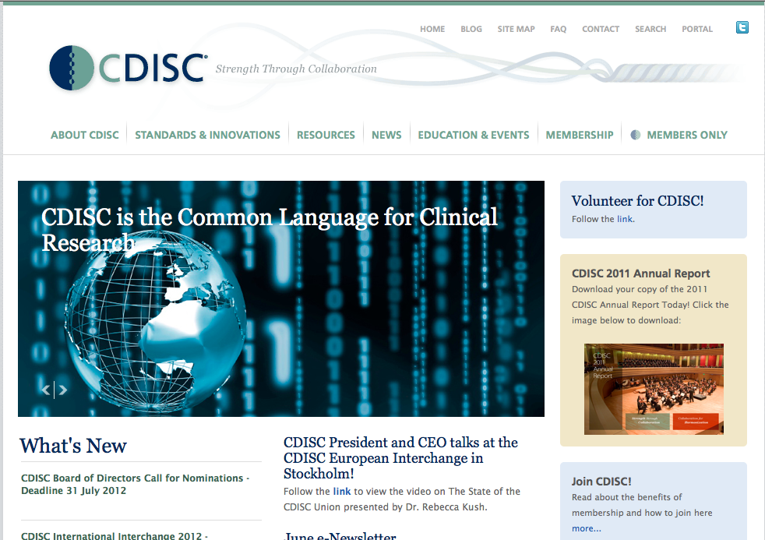
CDISC Snapshot
The CDISC Vision: informing patient care and safety through higher quality medical research.
Global, open, multi-disciplinary, vendor-neutral, non-profit standards developing organization (SDO)
Founded 1997, incorporated 2000
Member-supported (>300 member organizations: academia, biopharma, government, service and technology providers and others)
Liaison A Status with ISO TC 215
Charter agreement with HL7 (2001)
Leadership of Joint Initiative Council (JIC) for Global Harmonization of Standards
Member of ANSI-led ISO TAG
Active Coordinating Committees (3C)
Europe, Japan, China
>> 90 countries in participant database and/or downloading CDISC standards
CDISC Standards are freely
available via the website
www.cdisc.org
Notes:
Who CDISC is. Becky, this is one of your slides that I’ve cribbed for my Medtronic presentation.

Slide 6











Joint Initiative Council
IMI = European Union and EFPIA
Default is for IMI projects to use CDISC standards if available,
If not, partner in developing new standard.
JAPAN
Tranlational
Research
Informatics
Institute
Notes:
CDISC’s relationships. Another of your slides which I simplified for Medtronic. Please use the original if you’d prefer.

Slide 7
FDA PDUFA V Goals 2013-2017
Clinical Terminology Standards (Section XII E pg 28):
Using a public process that allows for stakeholder input, FDA shall develop standardized clinical data terminology through open standards development organizations (i.e., the Clinical Data Interchange Standards Consortium (CDISC) with the goal of completing clinical data terminology and detailed implementation guides by FY 2017.
http://www.fda.gov/downloads/forindustry/userfees/prescriptiondruguserfee/ucm270412.pdf
FDA has defined specific goals for development and use of data standards
7
Notes:
7

Slide 8


Global Clinical Research Standards End-to-End
Study Start-up
70-90% Savings
Study Conduct
40-60% Savings
Analysis and Reporting
50-60% Savings
Therapeutic Area Standards
Harmonized through BRIDG Model
and Controlled Terminology
Protocol
Representation
Model
(PRM)
Study
Design Model,
Clinical Trial Registration
eCase Report Forms
(CDASH)
Laboratory
(LAB)
Study
Data Tabulation Model (SDTM)
SEND for
pre-clinical data
Analysis Dataset
Model
(ADaM)
Operational Data Model (ODM)
XML Data Exchange
Define.xml

Slide 9
Healthcare Link Goal: Optimize the Research Process
data
conception
Healthcare
Delivery
(e)Source
Documents
EHR
(e)CRFs
eSource
Clinical
Research
Strategic Goal #3:
CDISC Healthcare Link – interoperability between clinical research and clinical care
auto
reconciliation
~1997
Notes:
Historical antecedent to healthcare link. This is a diagram developed by CDISC founders (Bron Kisler and Becky Kush) in 1997. It shows the opportunity to streamline research by sharing data electronically between EHRs and Research eCRFs, without entering that data on paper first. This vision is slowly but surely becoming a reality – a viable means of conducting clinical research.

Slide 10



Integrating Workflow: EHRs and Clinical Research
Safety
Clinical
Research
Public
Health
Quality
Adverse Event Report
Case Report Form
Outbreak Report
Secondary Uses
Quality Measure
Primary Use
EHR
Notes:
Introduce QRPH and CDASH. Research has the same problem as safety, public health, and quality, hence QRPH. The pivot shows the EHR replacing the human users as the way to send data to the outside agencies. The site located laptops can go away, replaced by data flows defined in integration profiles.

Slide 11

ASTER (Adverse Event Reporting from EHRs)
30 Ambulatory care physicians at Brigham and Women’s Hospital with Pfizer, CDISC, CRIX
Nov ’08– Jun ’09, > 200 Reports Sent to FDA
Physician Reporting:
*91% of participating physicians had submitted no adverse drug event reports in the prior year
*During the study, participants reported an average of 5 reports in a 3 month time period
*All participants reported at least 1 adverse event
* Process: Time to report decreased from ~35 minutes to < 1 min
* Source: Michael Ibara, Pfizer
Notes:
A notable early success.

Slide 12
RFD + CRD, the basic solution. George Cole, Allscripts

Slide 13


Integrating the Healthcare Enterprise (IHE) is an initiative by healthcare professionals and industry to improve the way computer systems in healthcare share information. IHE promotes the coordinated use of established standards such as HL7, CDISC, and DICOM to address specific clinical need s in support of optimal patient care. Systems developed in accordance with IHE communicate with one another better, are easier to implement, and enable care providers to use information more effectively.
Notes:
CDISC turns to IHE for help.

Slide 14
Retrieve Form for Data Capture (RFD)
Reduce the burden of reporting
Simple retrieval of externally hosted forms
Prepopulated with patient content where possible
Support many use cases
Investigational New Drug Clinical Trial Use Case
Public Health Reporting
Pharmaco-vigilance Scenario
Cardiology Research - Submission to National, State and Regional Data Registries
Radiology Use Case – Clinical Impact Registry
Data Clarification

Slide 15
RFD and CRD Timelines
2005: CDISC (Landen Bain) Proposes Profile Development
2005: Landen Bain, George Cole as editors for RFD Profile
July, 2006: Public Comment
Sept, 2006: Trial Implementation
July, 2009: Public Comment, round two
August, 2009: Trial Implementation
August, 2012: Final Status
2007:CDISC (Landen) Proposes Clinical Research Document(CRD) to Quality, Research, Public Health Domain
July, 2008: Public Comment
August, 2008: Trial Implementation

Slide 16
RFD and CRD: Contributing Organizations
Agfa
Allscripts
CDC
CDISC
Cerner
Epic
FDA
GE
Greenway
IBM
IHE
IPL
Medidata
Nextrials
Oracle
ORNL
Outcome
OZ Systems
Pfizer
Phase Forward
Quintiles
Tiani
…

Slide 18


RFD Roles: EHR + EDC + eSource
A
Archive Form
EHR
D
eSource
Form Filler
Submit Form
Retrieve Form
Form Archiver
B
C
EDC
Form Manager
Form Receiver
Slide courtesy Dave Iberson-Hurst
Notes:
Business relationships and Use Cases provide natural groupings of the RFD Actors. Clinical Research Domain: the Form Manager and Form Receiver are related, and most often reside on the same system, and may even be represented as a single actor, the Form Processor. With some Public Health use cases, there is a necessity to have completely separate Form Manager and Form Receiver.

Slide 19


RFD Retrieve Form
I’ve got Mrs. Jones here for her research visit and I need to retrieve her form so that I can do the data capture. And here’s some data on her to start off.
Research System
Sure, here’s the form we need for Mrs. Jones. I’ve inserted the data you sent me, and you do the rest.
Electronic Health Record
Notes:
Notice that we have:
A consenting patient
A research visit
Some data for the form
We leave the construction of the form, including the inclusion of current subject data, up to the research system.

Slide 20
RFD Submit Form
OK, here’s the completed form. Thanks for inserting the data I sent you. I’ve completed the rest and filed a copy.
Research System
OK, got it.
Electronic Health Record
Notes:
The burden of reporting was reduced – it was easy to host the form, and only data that was not supplied at the time of the request need be filled out.

Slide 21
Clinical Research Domain leverages RFD
Prepopulation Content
Continuity of Care Document (CCD)
Workflow Content
Subject ID
Site ID
Study ID
Investigator ID
…
Security and Auditing

Slide 22

Form Filler
Form Manager
Form Receiver
Form Archiver
Audit Record Repository
Create CRD prepop data document
Archive Source Documents [QRPH-36]
Record Audit Event [ITI-20]
Record Audit Event [ITI-20]
Retrieve Form [ITI-34]
Record Audit Event [ITI-20]
Record Audit Event [ITI-20]
Submit Form [ITI-35]
Record Audit Event [ITI-20]
Record Audit Event [ITI-20]
Archive Form [ITI-36]
Record Audit Event [ITI-20]
Record Audit Event [ITI-20]
RFD plus CRD showing Prepopulation, Security, Auditing
Notes:
All actors have synchronized time: [ITI-1]
All Transactions are TLS – mutual verification of certificates; Node Authentication [ITI-19]
All Transactions carry SAML assertions; Provide X-User Assertion [ITI-40]
All Transactions are logged by sender and by receiver to the Audit Record Repository; Record Audit Event [ITI-20]

Slide 23
What’s in the pipeline? Landen Bain

Slide 24
CDISC’s SHARE, IHE’s DEX, PhUSE Semantic Technology
SHARE is a metadata registry that will match specific CDASH terms to corresponding healthcare terms
Data Element Exchange (DEX) is an IHE integration profile that accesses SHARE and creates an ‘extraction specification’ that knows the location of desired data elements.
In conjunction with PhUSE and others, CDISC will begin the transition to semantic technologies such as RDF, SPARQL.

Slide 25

Clinical Research Document (CRD) Pre-population of a Case Report Form
Healthcare Site
Sponsor
CRD
XSLT
EHR
EDC
CCD
CDASH
eCRF

Slide 26
Extraction
Specification
Healthcare
Research
EHR
eCRF
EDC
3. Data as CCD
CCD
2. Form as ODM
1. Build form from CDASH elements in SHARE
SHARE

